Slide 1

DriverPass
System Analysis
Carlos Affonso
Notes:
[No speaker notes required for this slide.]

Slide 2

System Requirements
Functional Requirements
Ability to create new courses.
Ability to manage users along with tracking their changes.
Nonfunctional Requirements
Compliance with DMV, along with connectivity
24 hour, reliable uptime
Notes:
For these functional requirements, I considered the admin’s position in the hierarchy. Through this system, a User with privileges can create new courses, and they can later check all changes made to the system. Another priority while developing this was to make sure that it complied with standards set by the DMV. Finally, its Cloud hosting makes sure that the service is up 24/7.

Slide 3
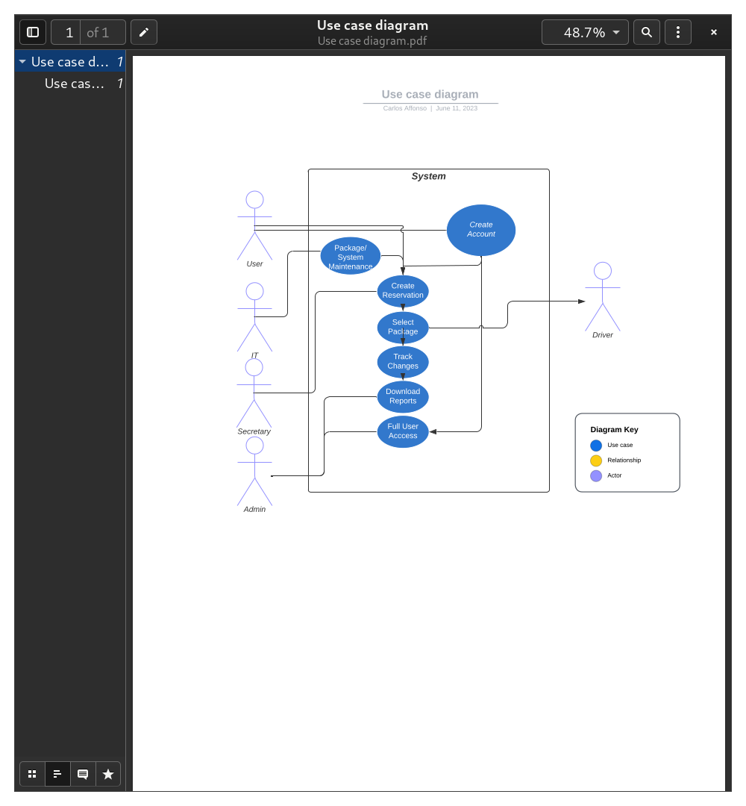
Use Case Diagram
Notes:
This diagram simply shows the different types of people who might interact with DriverPass. In particular, I’ve outlined the process of an account being created and how that reports back to an admin through the process of that change being visible to them in the reports they may generate.

Slide 4
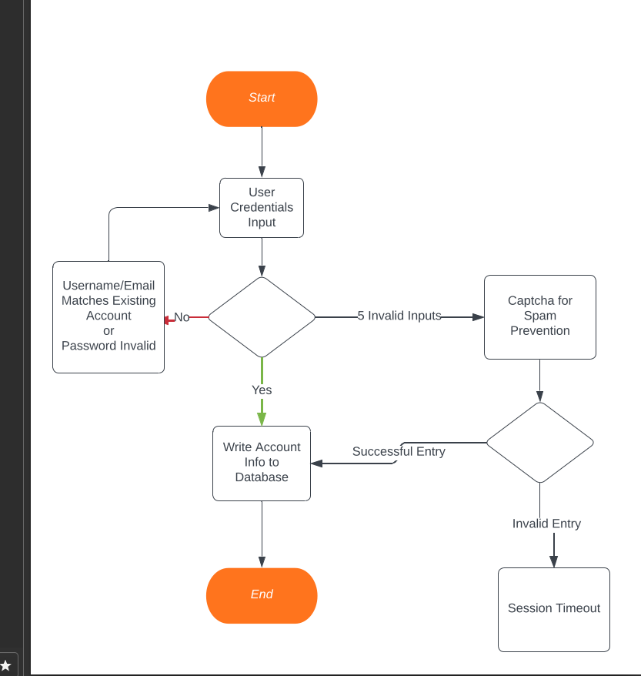
Activity
Diagram
Notes:
This diagram showcases the process of creating a new account. In particular, after the user has tried to make an account and has failed 5 times, a captcha is generated to make sure that this isnt a bot spamming the system. If the user fails after that, their session is locked out. This guarantees that the system is safe agaisnt spamming.

Slide 5
Security
Actors only have access to their information
Lockguards agaisnt automated attacks, and targeted attacks
Notes:
I made sure that each kind of user only has access to what they should be seeing and no one else. I’ve also put in measures to prevent popular methods of “breaking” a system, like preventing spamming passwords, spamming accounts, etc.

Slide 6
System Limitations
Digital Assets are not present, UI is very barebones
No Beta testing, edge cases tested but that’s the only extent of it.
Notes:
As it is, this system is lacking a personal touch. The actual website and how it looks, what it uses, has not been considered. Also with that, the system so far has not been used by a customer, and the experience may reflect that. I’ve attempted to keep them in mind but the User Experience may differ.

